Slide 1
Phase 3 PROJECT
A PREDICTIVE MODEL FOR H1N1 & SEASONAL FLU FOR HEALTHCARE PROVIDERS.

Slide 2
Overview
The dataset comes from the national 2009 h1n1 flu survey, aimed at monitoring vaccination coverage during the 2009-2010 flu season. the dataset includes information on vaccination rates for both the h1n1 and seasonal flu vaccines.
h1n1 vaccine : whether an individual received the h1n1 vaccine(yes/no)
seasonal vaccine: whether an individual received the seasonal flu vaccine(yes/no)

Slide 3
Business & Data understanding
Target and engage specific demographics more effectively.
Optimize resource allocation and improve the efficiency of healthcare providers.
Enhance strategic planning and policy development.
Personalize patient communication and education efforts.
Monitor and evaluate the impact of vaccination campaigns.

Slide 4
Cont.
The survey targeted individuals aged 6 months and older across the united states, capturing a broad demographic range. This implies that the dataset includes diverse age groups and potentially various socio-economic and health-related factors. It also includes demographic details such as age, gender, income, and education. this information is crucial for understanding the distribution of vaccination rates among different population segments.

Slide 5
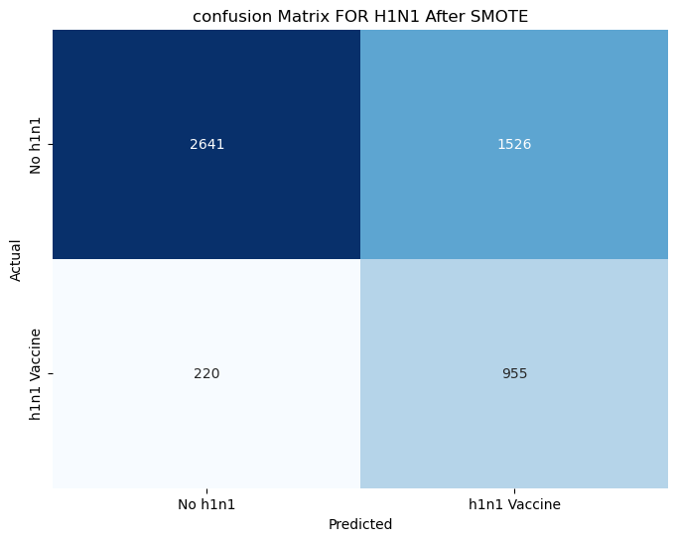

Slide 6
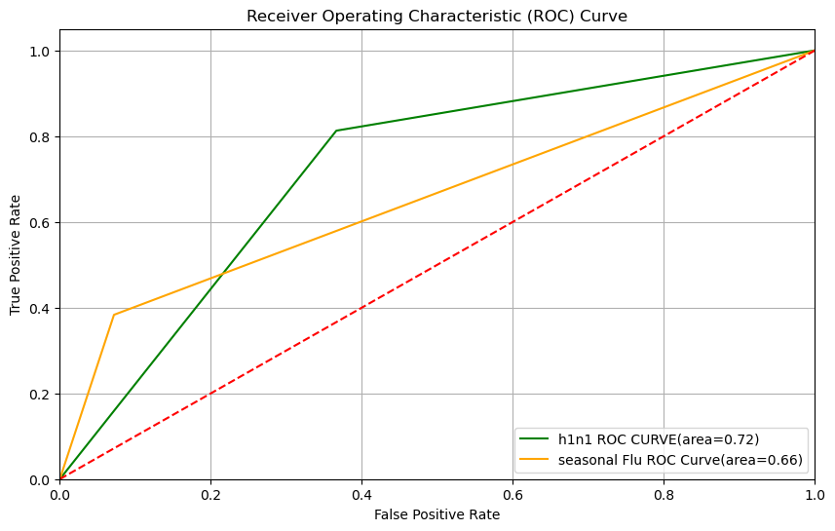
Modeling

Slide 7
Evaluation
Precision is at 63% indicating that all the predictions that were made 63% were correct.
The model correctly identified 93% of the actual class 0 individuals indicating that the model is good at predicting those who didn’t receive the flu vaccine.
f1 score balances precision & recall showing a good balance of 75%.
Overall accuracy of the model is 67%.

Slide 8
Recommendation
Address class imbalance: implement techniques to handle class imbalance, such as resampling methods or using algorithms designed for imbalanced data.
External validation: test the model on external datasets or in different healthcare settings to assess its performance in varied conditions.
Continuous monitoring: once deployed, continuously monitor the model’s performance to ensure it remains accurate and effective over time.
Feedback loop: incorporate feedback from healthcare professionals to refine and improve the model based on real-world performance and challenges.

Slide 9
THANK YOU

